Slide 1
Poverty and Fast-food locations
Edwin Ng & Bryce Deckard

Slide 2

GENERAL OVERVIEW
Are Fast Food Restaurants more likely to open in poverty-stricken areas?
Is it more a cause and effect or a correlation?
What are some other factors that play in part with Fast Food locations?

Slide 3

IMPORTANCE OF STUDY
-11% or around 36.8 million Americans live in poverty
-Allows us to investigate possible correlations between fast-food locations and increased poverty
-Understanding these correlations would help policymakers, urban planners, and government understand how effectively address these issues.
-A study from UC Berkley showed 52% of families reliant on fast-food jobs for income are also enrolled in public programs such as SNAP benefits, Medicaid, or Section 8 housing programs. Compared to the 25% average for the entire workforce.

Slide 4
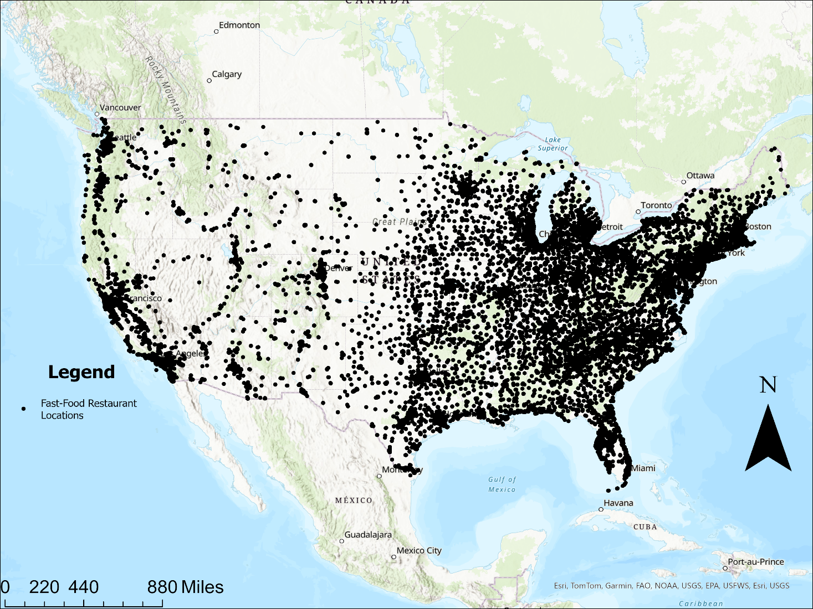
Fast-Food locations in the United States
-207,827 fast-food restaurants
-1.5% increase per year in fast-food locations in 2018-2023
-Locations based on ArcGIS Hub Fast Food Locations (2018)
-These Restaurants included:
McDonald’s
Burger King
Pizza Hut
Taco Bell
Wendy’s KFC
Jack-in-the-Box
Hardee’s
Carl’s Jr.
In-N-Out

Slide 5
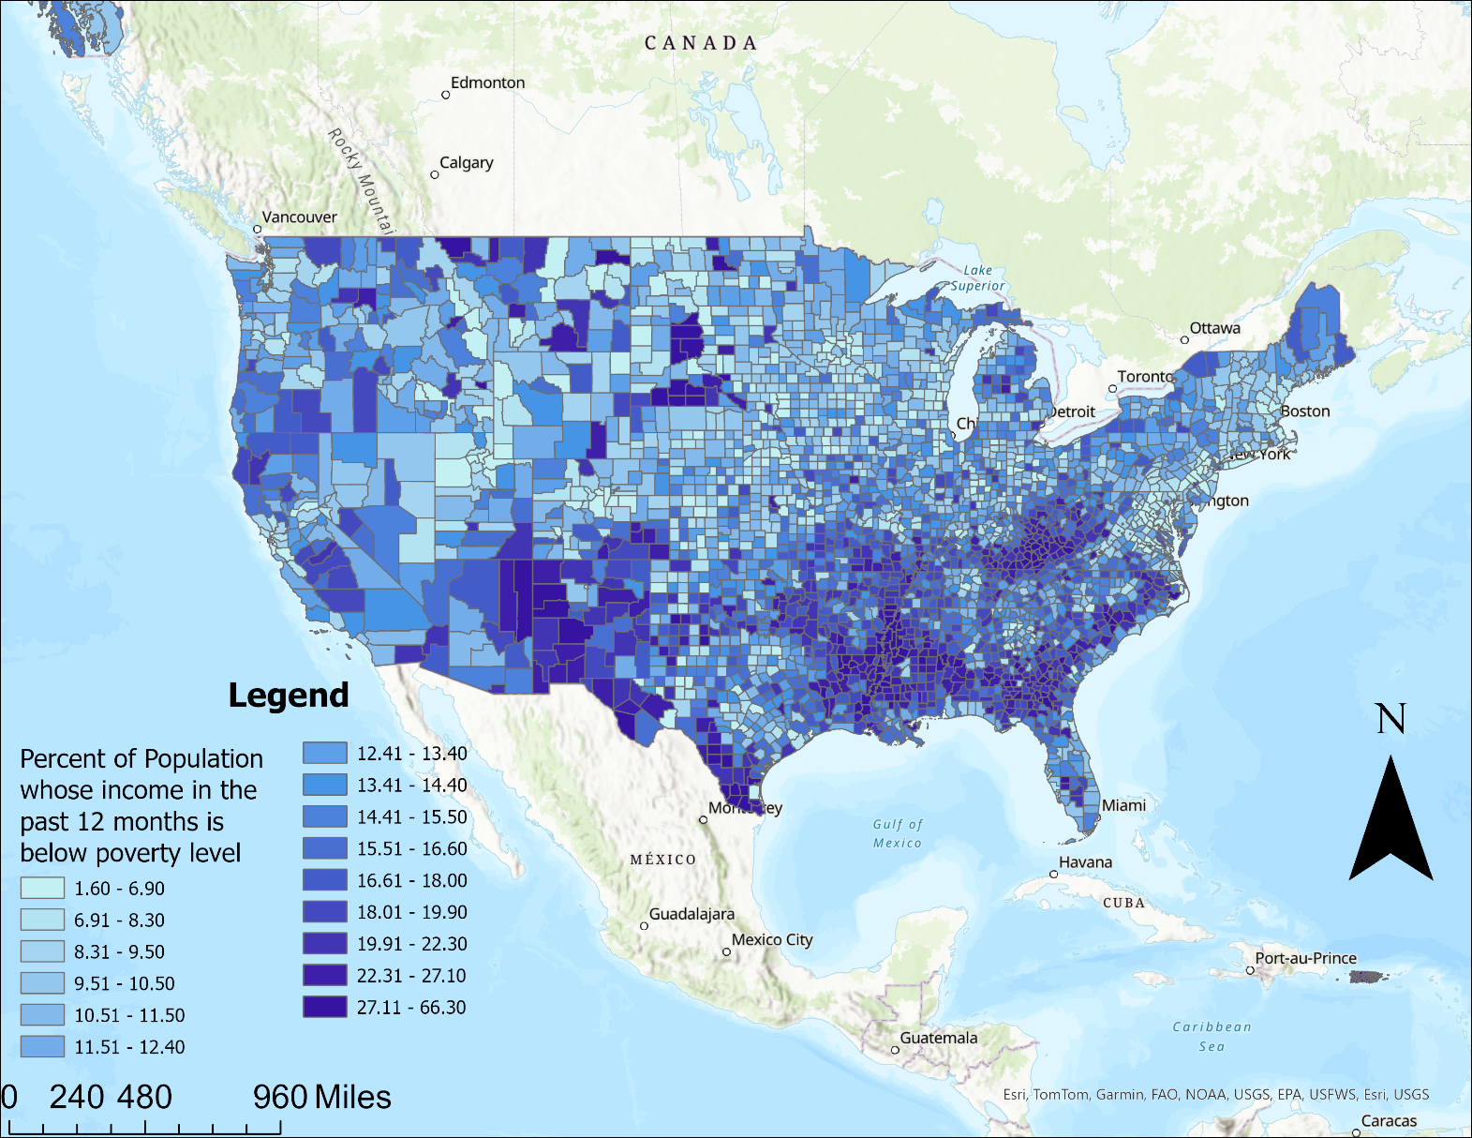
Poverty Percentage at county level
-This map visualizes the percent of the population deemed to be below the poverty level within the last year
-We can see poverty concentrated in the Appalachian Mountains, The South, and The Dakotas
-Poverty data obtained from US Census Data, American Community Survey

Slide 6
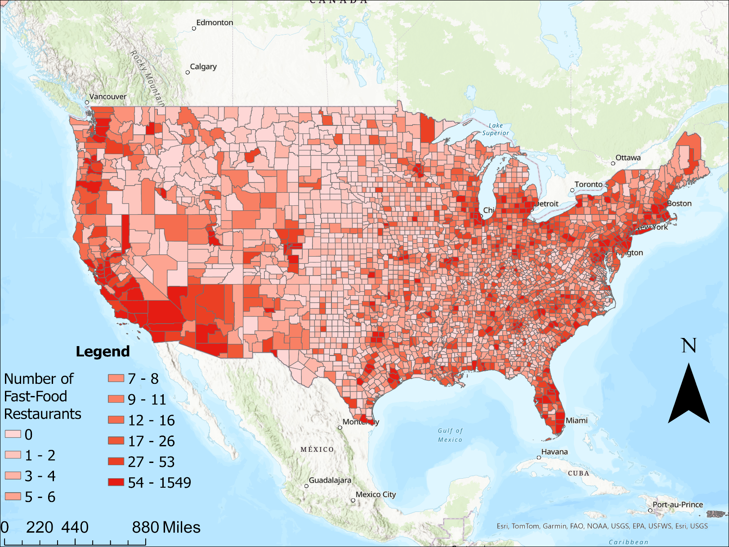
Fast-food density at county level
-This map shows the number of fast-food locations at the county level
-We can see an increased density of fast-food locations along the East and West Coasts of The U.S.
-More fast-food in urban areas
-Using Spatial Join to combine fast food locations and counties from Census data

Slide 7
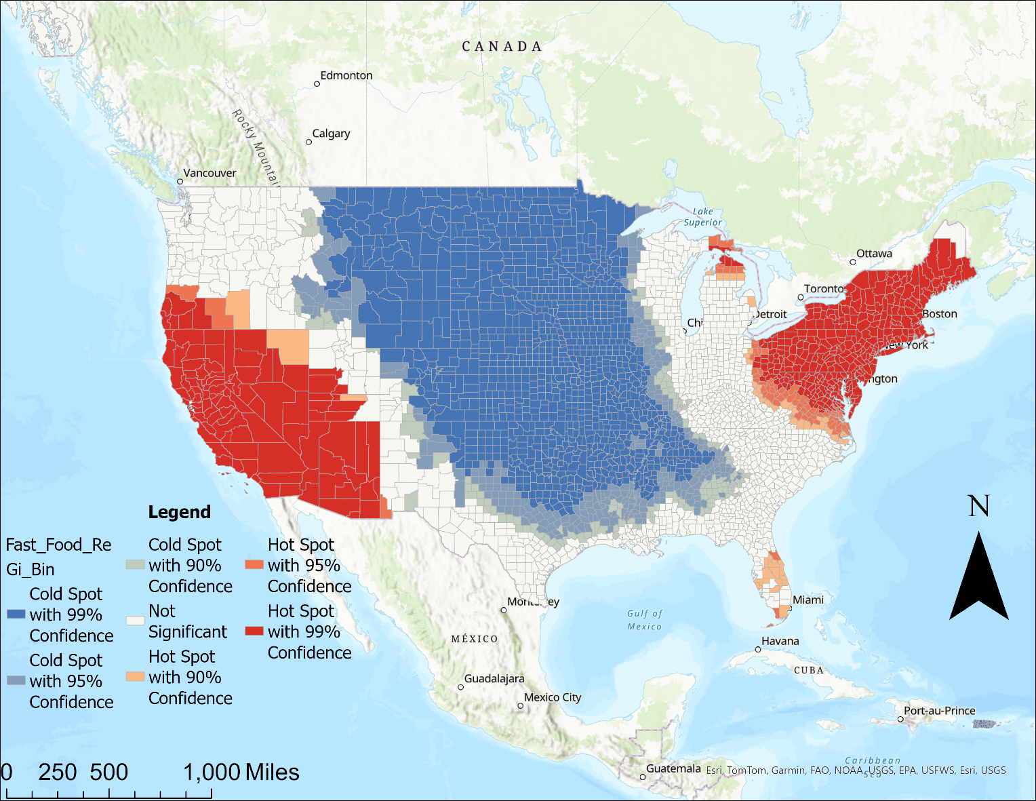
Hotspot Analysis of fast-food locations nationally
-Areas in red indicate there is a high confidence of fast-food locations being densely clustered.
-Areas in blue show less clustering of fast-food locations
-Difference in clustering normally due to population density, increased economic activity, and urbanization
-Using Hotspot Analysis function, obtained significance of fast-food locations nationwide based on fast-food density

Slide 8
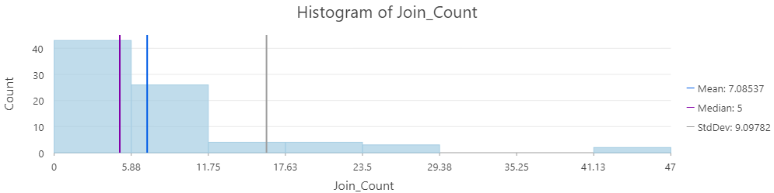
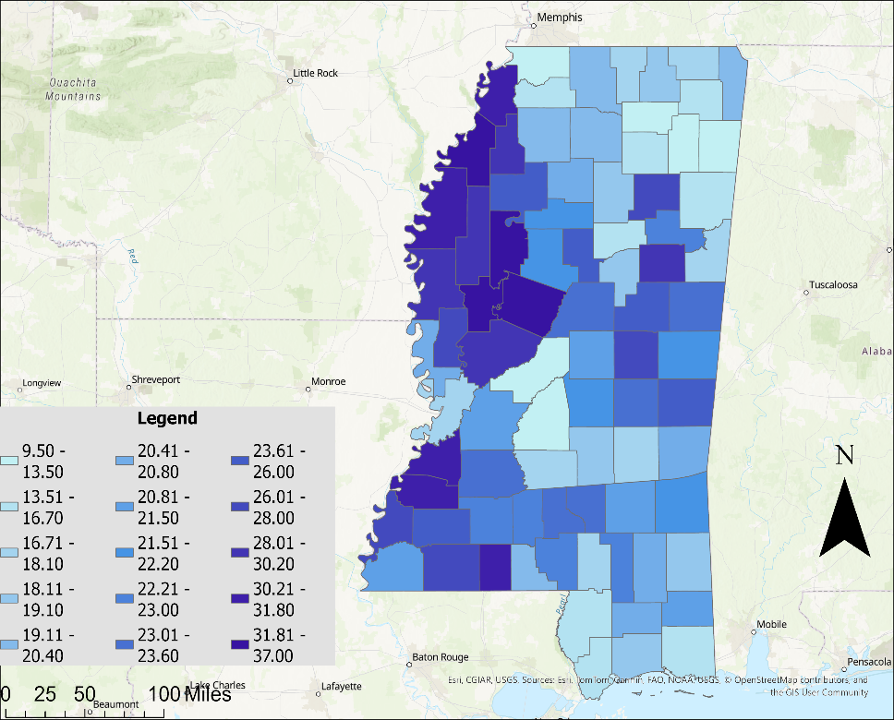
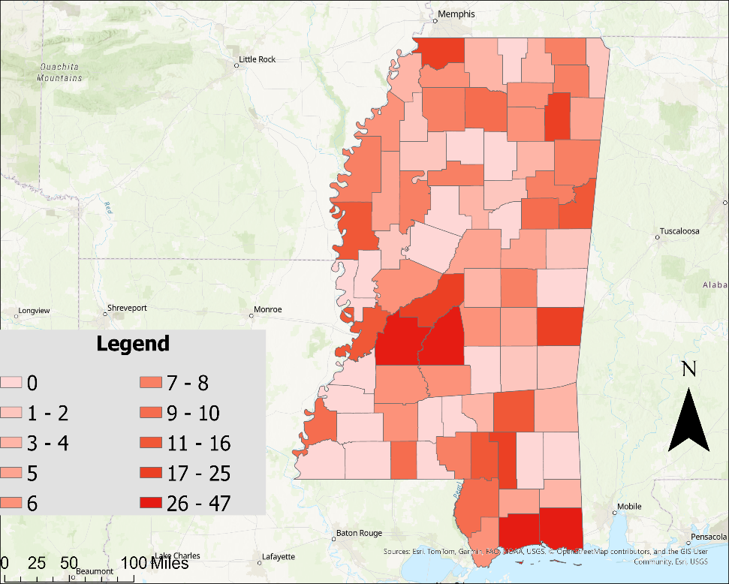
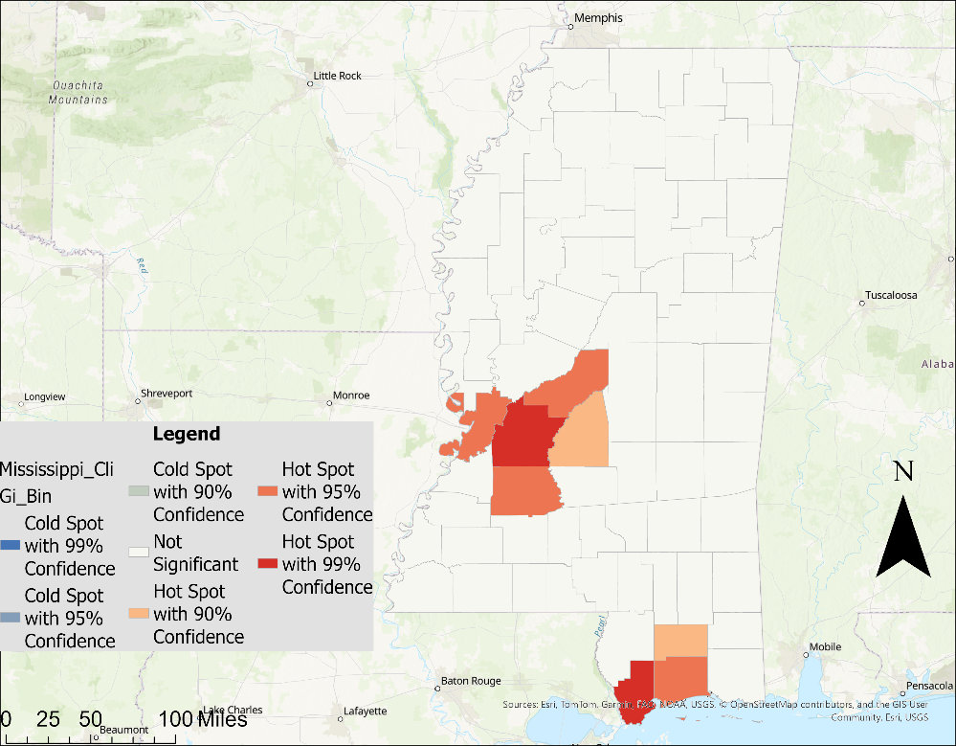
Clipped images of Mississippi Analysis
-The 1st map shows the poverty level by county of Mississippi
-The 2nd map shows the density of fast-food locations by county of Mississippi
-The 3rd shows a hotspot analysis of Mississippi
-In Mississippi fast-food locations are clustered around the capital city Jackson, and near the ocean in Gulfport

Slide 9
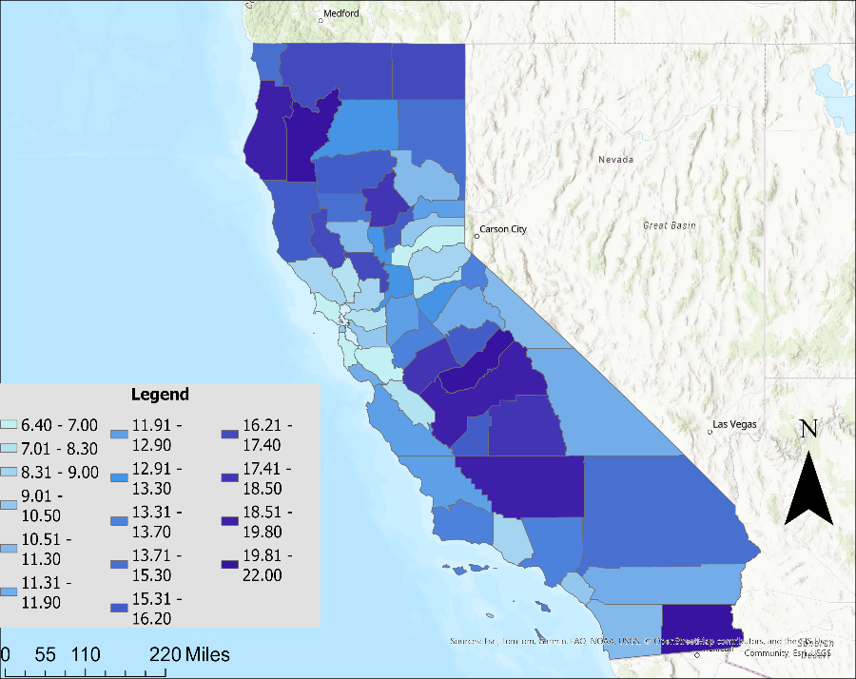
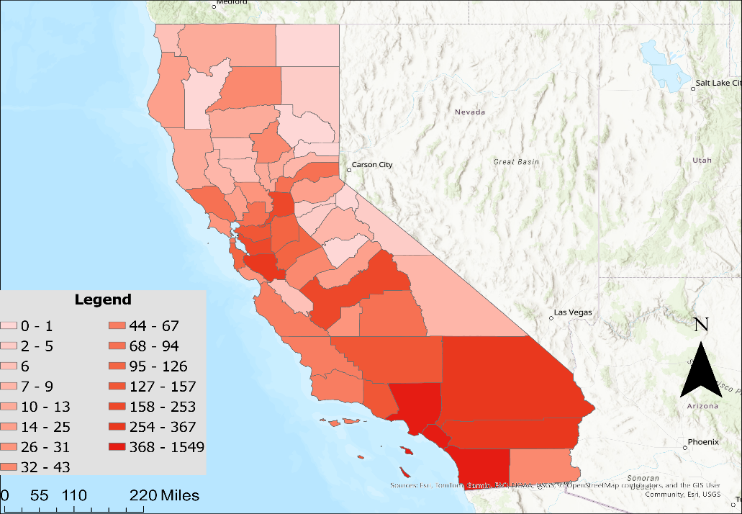
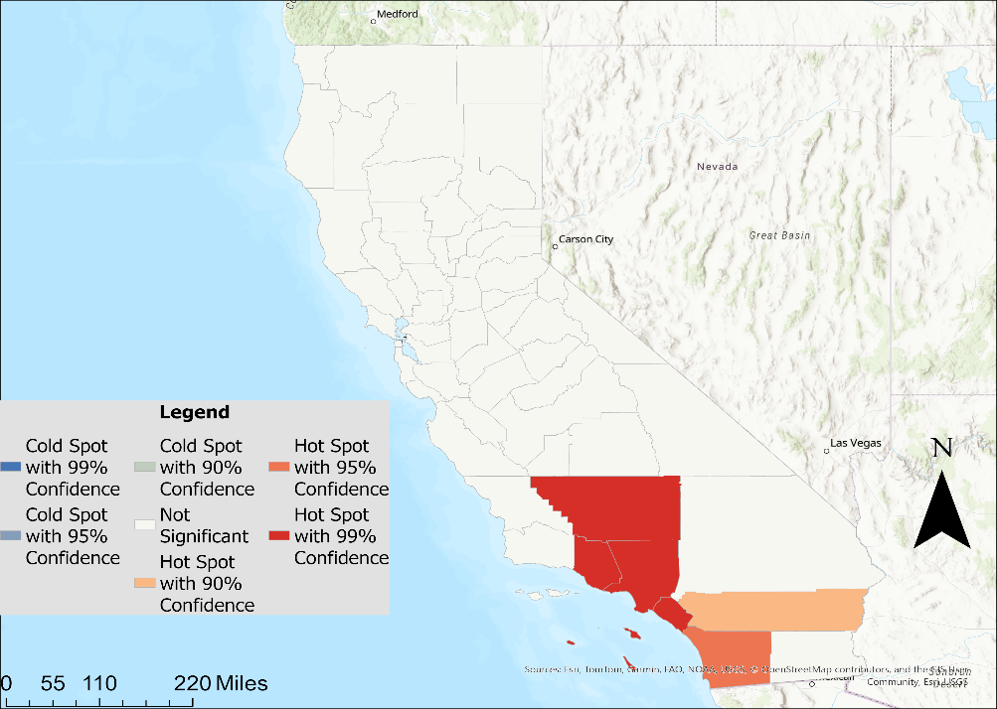
Clipped Images of California Analysis
-These maps again show poverty by county, fast-food locations by county, and a hotspot analysis
-In California, the poverty in most prevalent in the Central Valley and the Northern tip
-Fast-food locations are most clustered around the big urban areas of Los Angeles, San Diego, and San Francisco

Slide 10
Conclusion
-Fast-food restaurants are more likely to open a location in higher percentage poverty areas
-There is a correlation between higher percentage of people in poverty and number of fast-food locations in places such as the east and west coast
-However, this does not mean people in poverty are more likely to eat fast food

Slide 11
Limitations
We don’t know the consumption rates between the different socio-economic classes of people
This doesn’t include all the fast-food restaurants leading to potential data being missing during the spatial joining of data maps
ArcGIS analysis can establish correlation but not establish causation… maybe poverty levels do draw in more fast-food locations, but it is too difficult to tell
There is the existence of confounding variables such as population density, education levels, and access to transportation leading to misleading conclusions
County level doesn’t tell all the story as inside the county there may be a range of poverty ranges in of itself with different neighborhoods, cities, and even entire regions

Slide 12
Sources
-“IBISWorld - Industry Market Research, Reports, and Statistics.” IBISWorld Industry Reports, 2024, www.ibisworld.com/industry-statistics/number-of-businesses/fast-food-restaurants-united-states/#:~:text=There%20are%20207%2C827%20Fast%20Food,over%20the%20past%205%20years%3F.
-Allegretto, Sylvia, et al. “Fast Food, Poverty Wages: The Public Cost of Low-Wage Jobs in the Fast-Food Industry.” UC Berkeley Labor Center, 3 Apr. 2024, https://laborcenter.berkeley.edu/fast-food-poverty-wages-the-public-cost-of-low-wage-jobs-in-the-fast-food-industry

